Slide 1
IMPACTS OF dATA AUGMENTATION ON bREAST CANCER CLASSIFICATION WITH cnn
GROUP 1 何倩倩
2023/03

Slide 2
Content
I. Introduction
II. Methodology
III. Experimental study
V. Conclusion
VI. Future work

Slide 3
Introduction

Slide 4
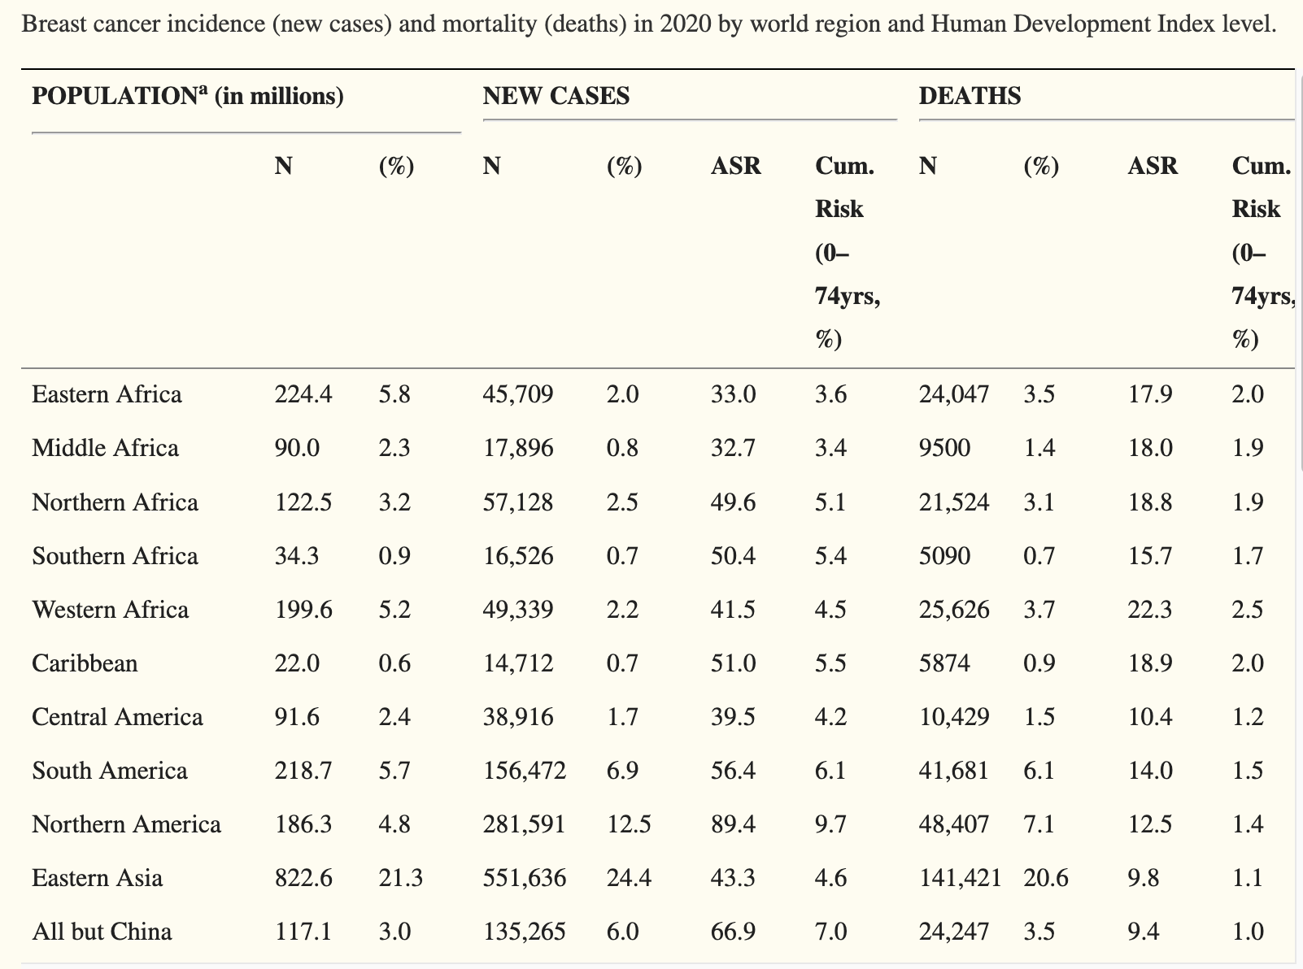
Breast cancer is a cruel killer. need Early detection
In 2020, an estimated 2.3 million cases of female breast cancer were diagnosed globally, and about 685,000 women died from the disease. Breast cancer is now a cruel “killer” for women.
To cut the death rate, early detection with the help of medical images using breast ultrasound scan is one of the most effective and painless ways.

Slide 5
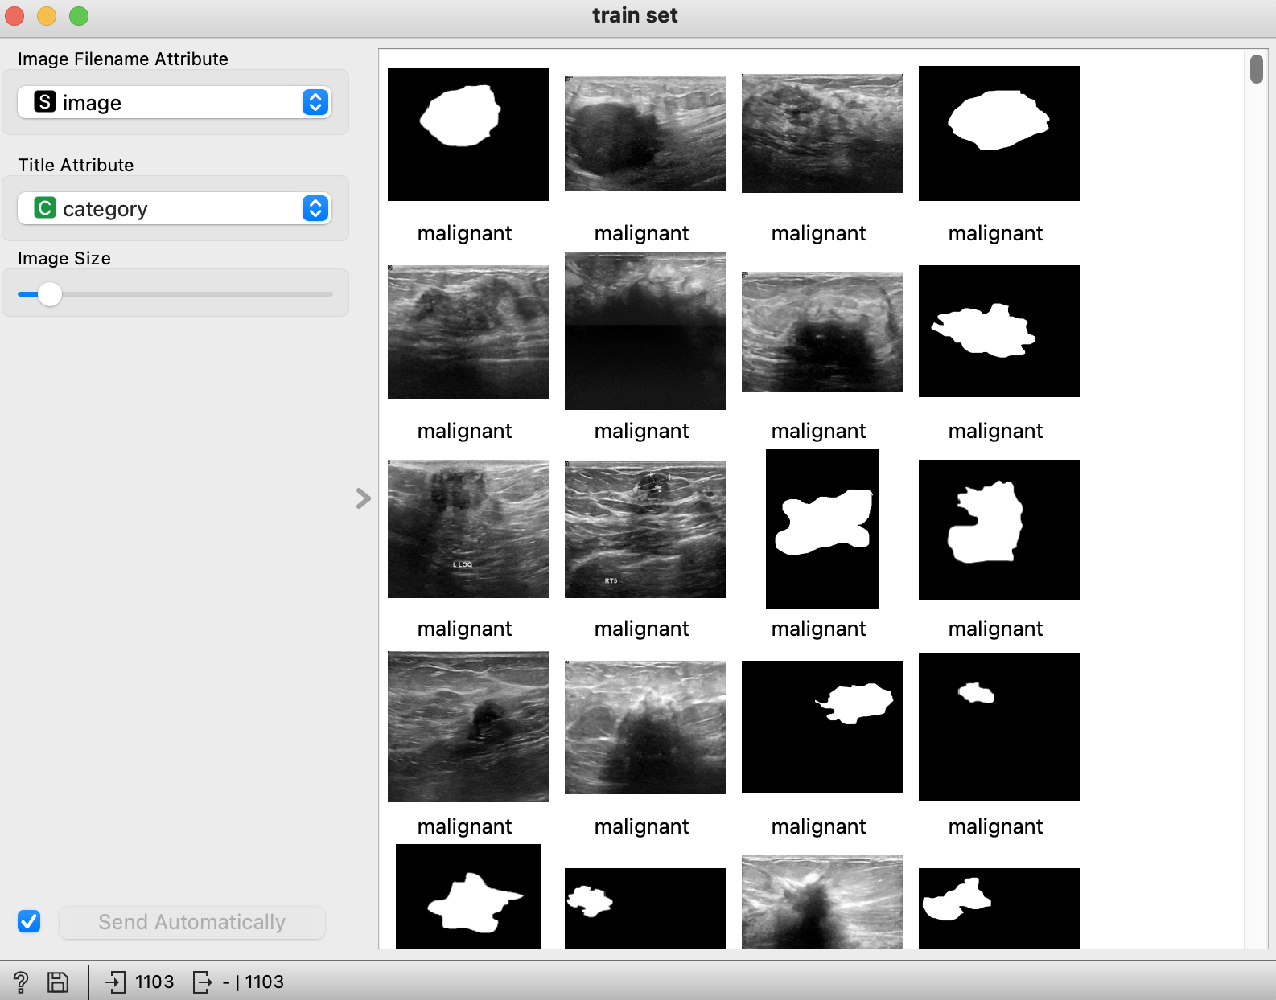
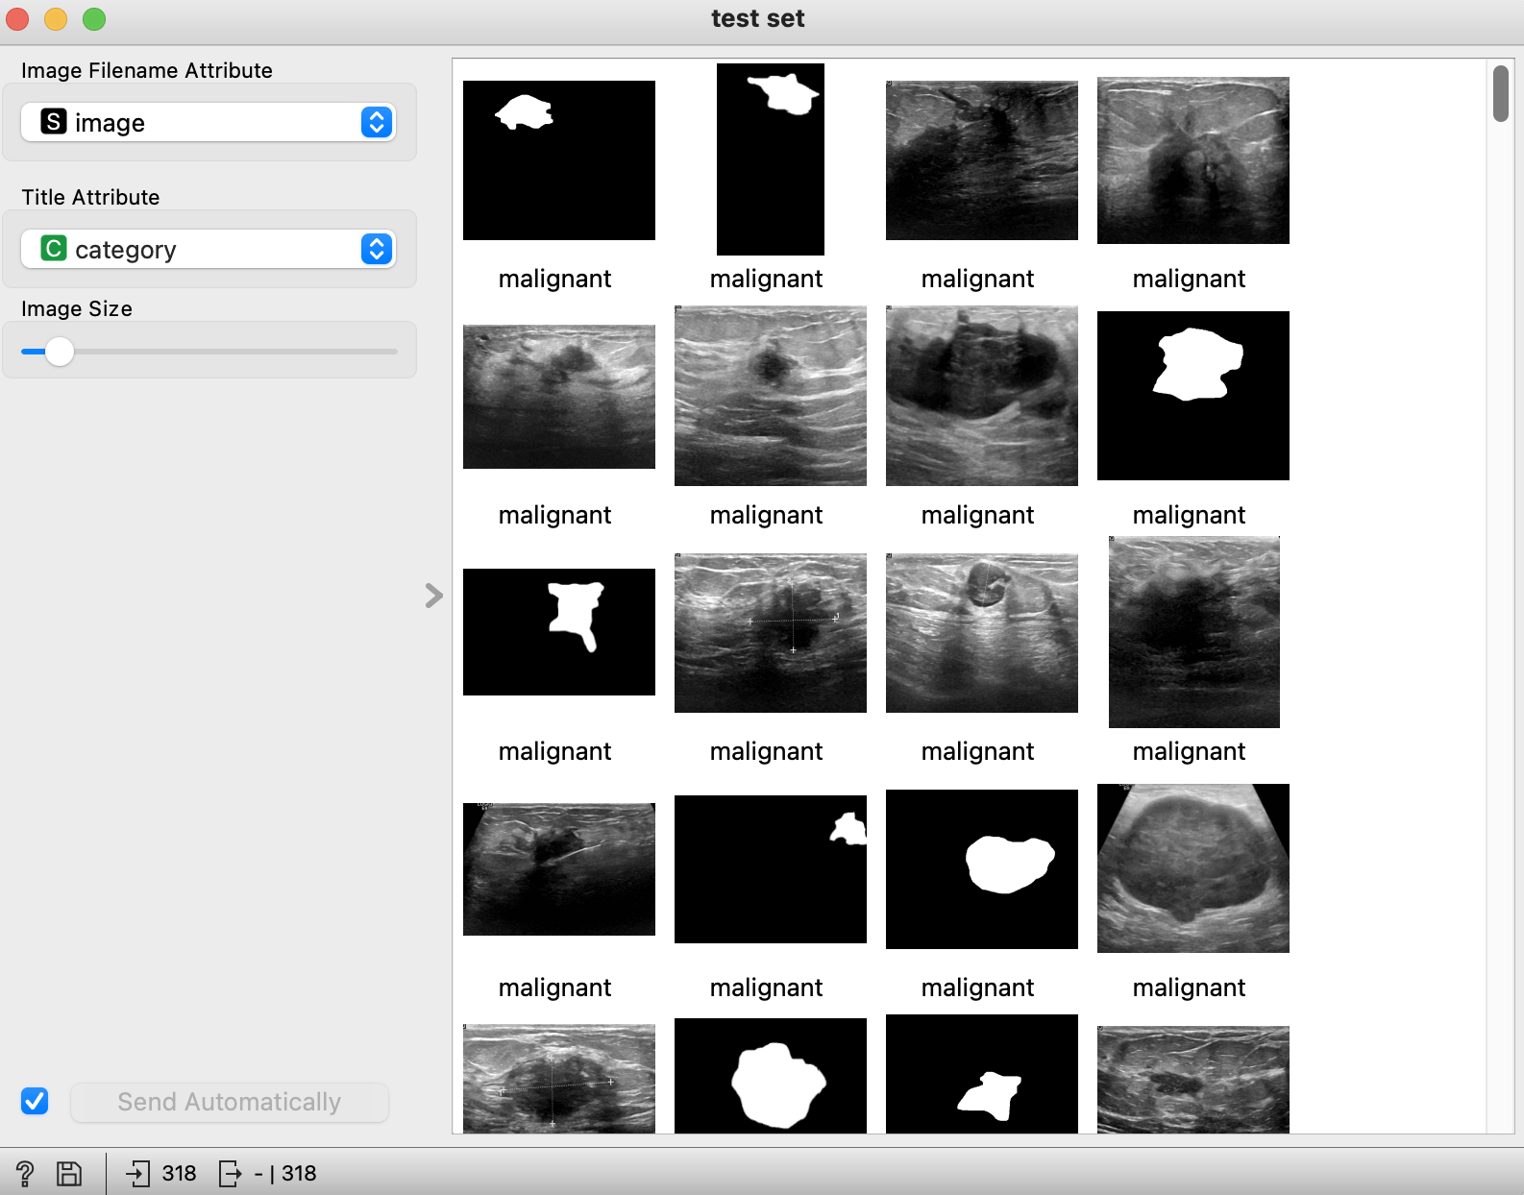
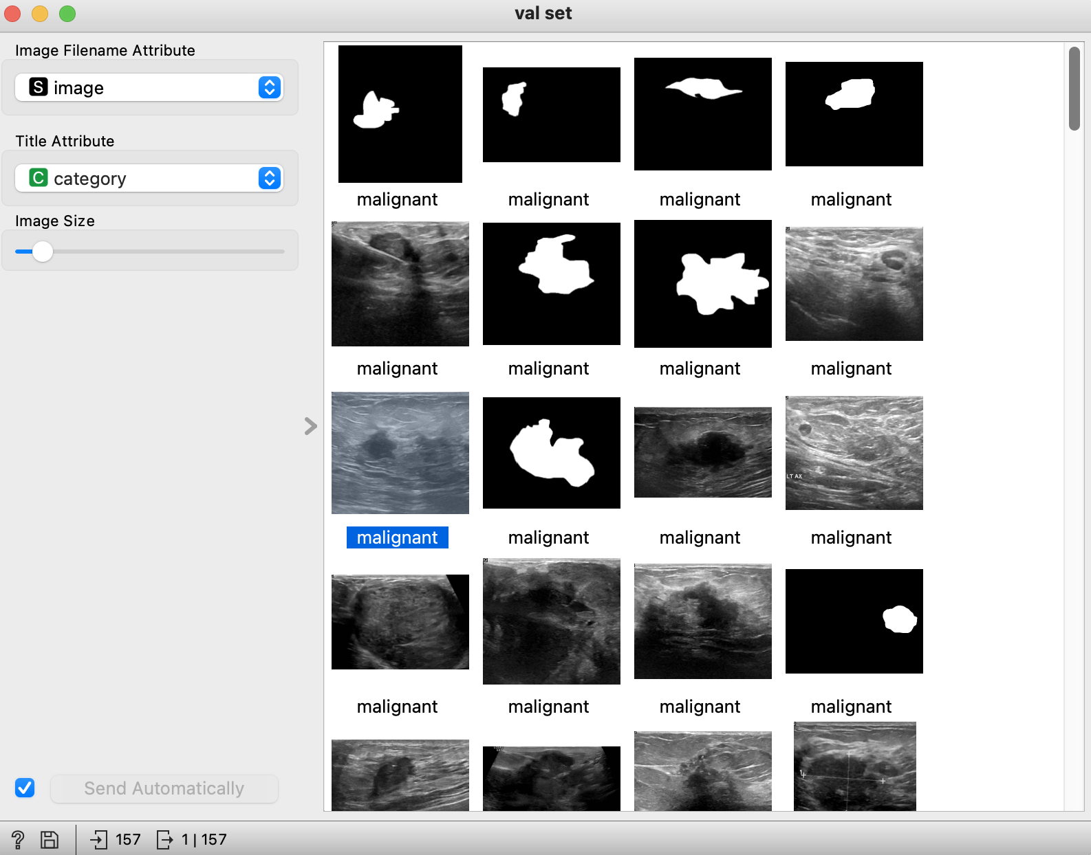
Which leads us to how to process medical images
Breast ultrasound images can be categorized into normal, benign, and malignant images. Using machine learning to process images can improve classfication , detection, and segmentation of breast cancer.
About the dataset
Collected in 2018 among 600 women in ages between 25 and 75 years old
1578 images (PNG), 500*500 pixels
Train(1103): Test (318): Val(157) --> 7:2:1

Slide 6
methodology

Slide 7
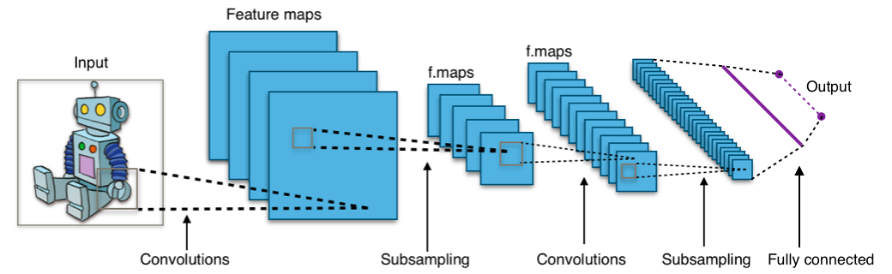
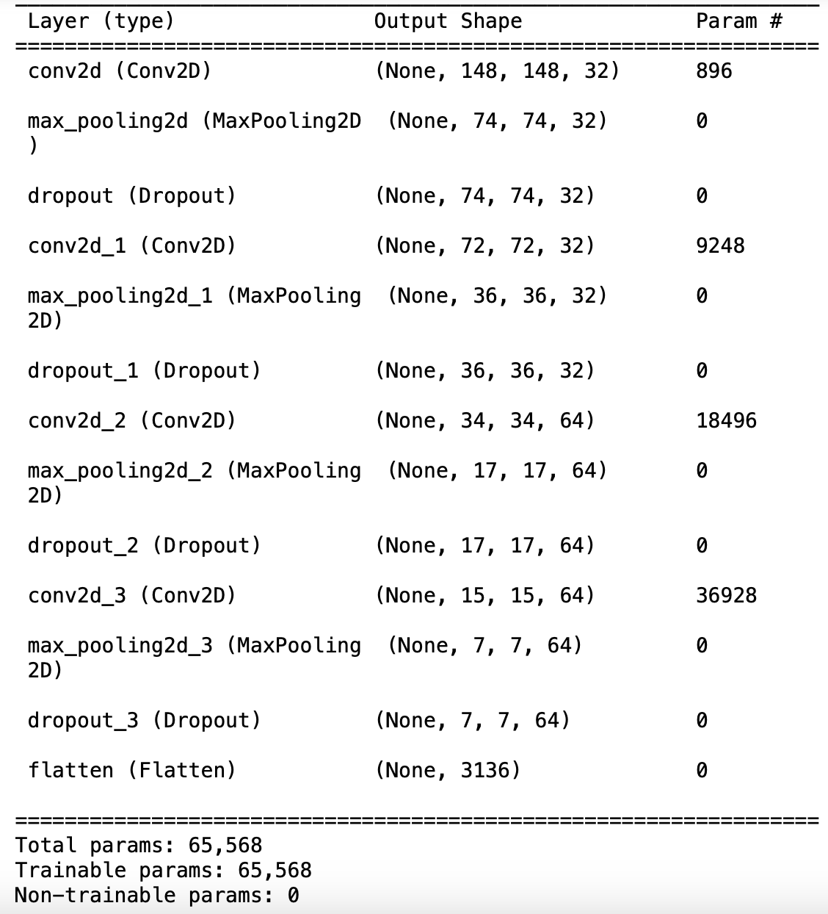
Cnn FOR CLASSFICATION
CNN, Convolutional neural networks, are a specialized type of artificial neural networks that use a mathematical operation called convolution in place of general matrix multiplication in at least one of their layers. They are used for image recognition and processing.
Convolution and pooling layers
4 convolution layers and 4 max pooling layers
3 x 3 filters in convolutional layers
Use Dropout to reduce overfitting

Slide 8
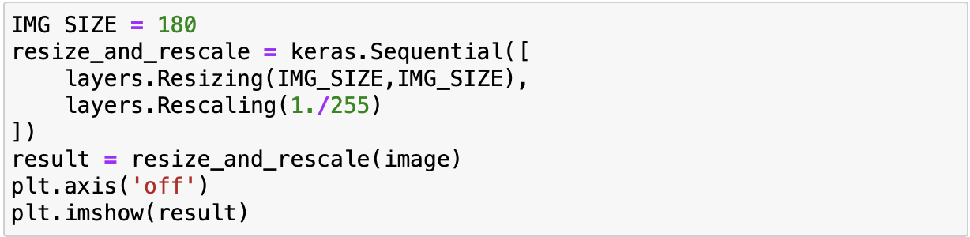
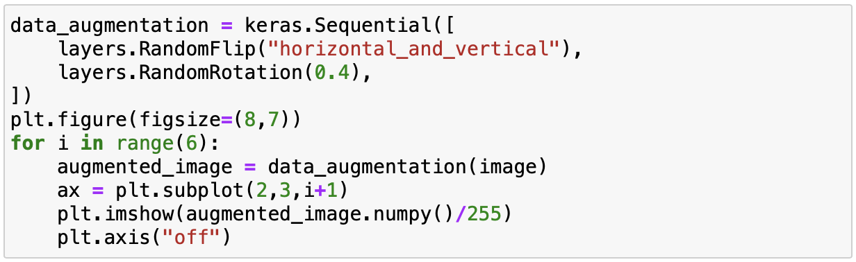
Data augmentation WITH KERAS SEQUENTIAL
Resize and rescale
Random rotate and flip
Use Keras Sequential and image augmentation layers. First resize the image to 180x180 and then rescale it by 1/255.
Use loop, subplot, and imshow to display images with random rotate and flip.

Slide 9
EXPERIMENTAL STUDY

Slide 10
How we do experiments
Step 1:
Analyze accuracy with no data augmentation using CNN. Use the results as reference.
Step 2:
Process train set with resize and rescale, random rotate and flip.
Step 3:
Train models on the different train sets and record the accuracy on val set.
Step 4:
Analyze test set with models and record the accuracy.

Slide 11
What are the RESULTs
 | Resize and rescale | Random rotate and flip | Origin
Train | 0.985 | 0.997 | 1.000
Test | 0.893 | 0.921 | 0.914
On the train set
The accuracy is affected by resize and rescale and random rotate and flip.
On the test set
The accuracy is reduced by resize and rescale. It is improved by random rotate and flip.
random rotate and flip reduces overfitting

Slide 12
CONCLUSION

Slide 13
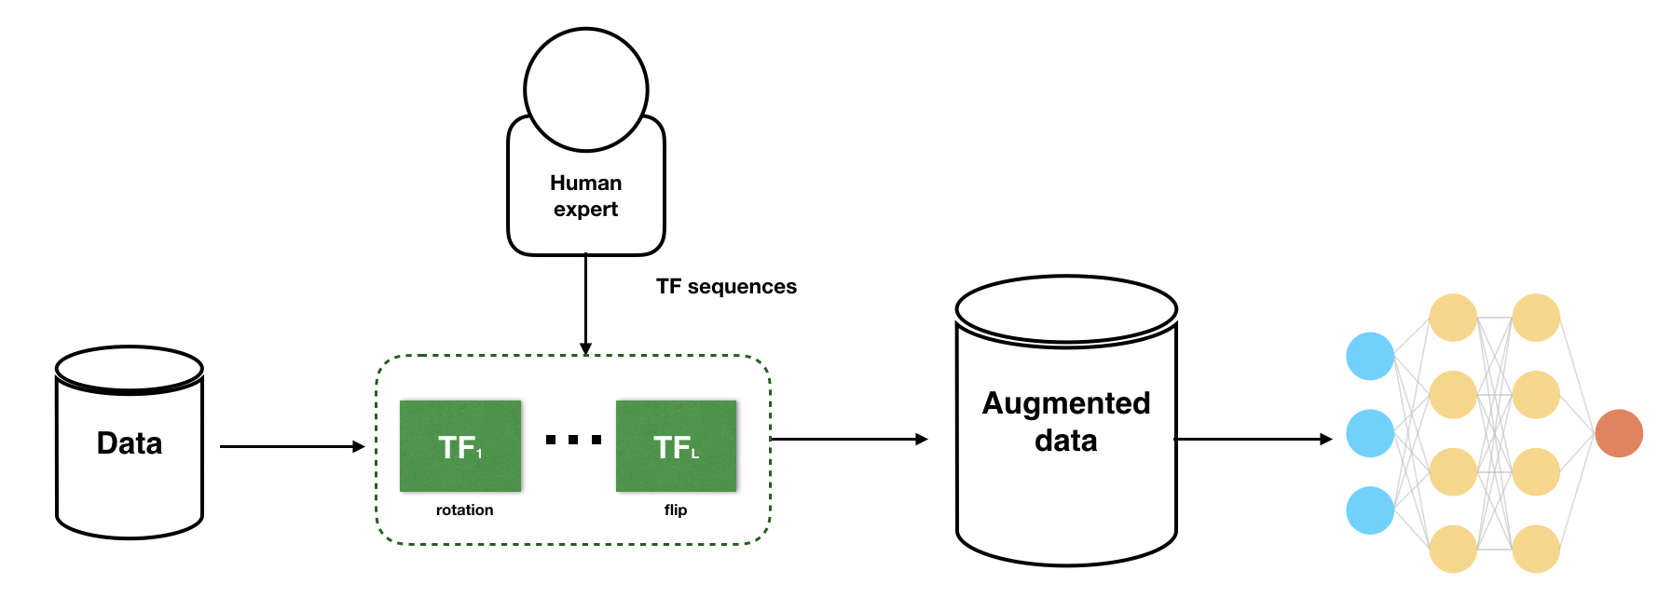
What we have learned about impacts of DATA AUGMENTATION
Data augmentation is a de facto technique used in nearly state-of-the-art machine learning model in applications such as image classification. When chosen carefully, data augmentation schemes turned by human experts can improve model performance.
As indicated by the diagram, compared with resize and rescale, random rotation and flip makes the model more robust, as a result, it can reduce overfitting problem. Random rotate and flip is helpful for classification of breast cancer. Data analysts can use this method to identify medical images of breast ultrasound scan and detect breast cancer more efficiently.

Slide 14
FUTURE WORK

Slide 15




What to do next ...
Increase sampling size
Try more data augmentation methods for the same data set such as DNN, GAN, etc.
Use data augmentation methods for various image datasets, e.g., MRI dataset, etc.
Test the impact of one data augmentation method on different methods like VGG16

Slide 16
references
[1] Melina Arnold, Eileen Morgan, Harriet Rumgay, Allini Mafra and Isabelle Soerjomataram. Current and future burden of breast cancer: Global statistics for 2020 and 2040 [J]. Breast, 2022 Dec; 66: 15–23.
[2] Sharon Y.LI. Automating Data Augmentation: Practice, Theory and New Direction. The Stanford AI Lab Blog, 2020.
[3] Alex Krizhevsky, Ilya Sutskever, and Geoffrey E. Hinton. 2017. ImageNet classification with deep convolutional neural networks. Commun. ACM 60, 6 (June 2017), 84-90.
[4] Al-Dhabyani W, Gomaa M, Khaled H, Fahmy A. Dataset of breast ultrasound images. Data in Brief. 2020 Feb;28:104863. DOI: 10.1016/j.dib.2019.104863.

Slide 17
thanks

